Slide 1
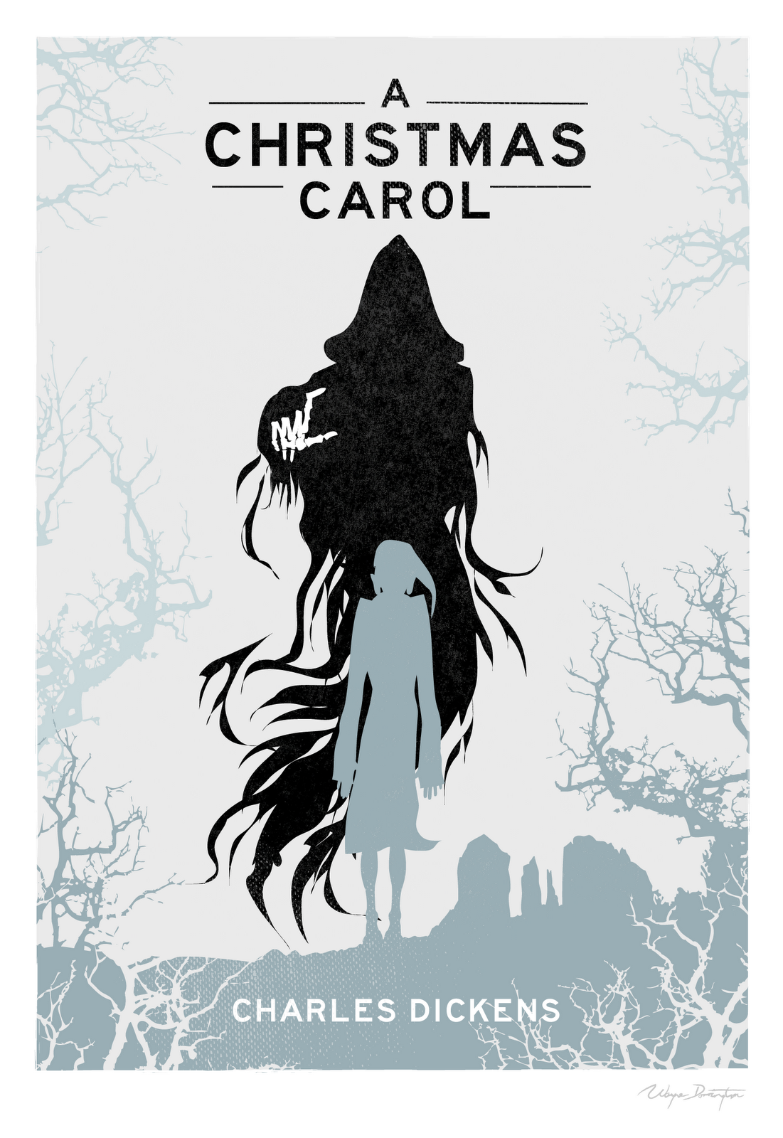
Quotation PowerPoints
Structure
Introduce five quotes
Test them to see how much they remember
Explode the quote / Identify techniques and features
Dazzle point

Slide 2
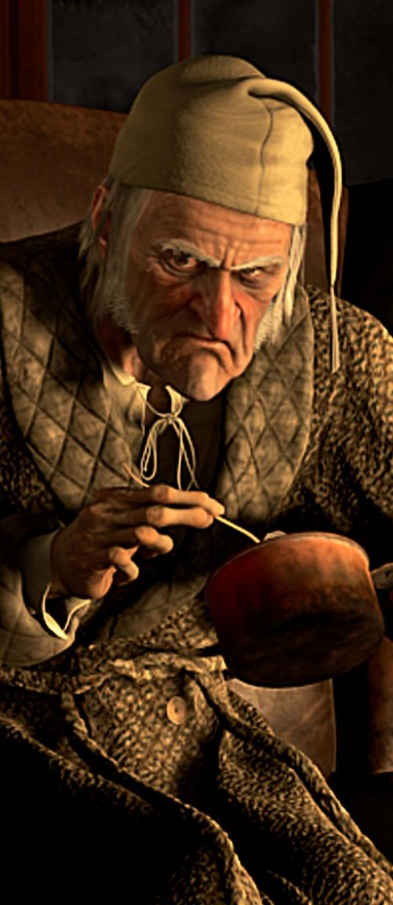
Ebenezer Scrooge Learn these quotations by memory
‘Are there no workhouses? Are there no prisons?’
‘Hard and sharp as flint… solitary as an oyster.’
‘The cold within him froze his old features’
‘Foggier yet, and colder. Piercing, searching, biting cold.’
‘If they would rather die they had better do it, and decrease the surplus population.’

Slide 3
Ebenezer Scrooge (Please differentiate as appropriate.)
‘Are there no ____________? Are there no _________?’
‘_______ and sharp as ______… solitary as an __________.’
‘The _________ within him froze his old __________’
‘___________ yet, and colder. __________, searching, ________cold.’
‘If they would rather ______ they had better do it, and _________ the _________ population.’

Slide 4
Ebenezer Scrooge
‘Are there no workhouses? Are there no prisons?’
‘Hard and sharp as flint… solitary as an oyster.’
‘The cold within him froze his old features’
‘Foggier yet, and colder. Piercing, searching, biting cold.’
‘If they would rather die they had better do it, and decrease the surplus population.’

Slide 5
‘Hard and sharp as flint… solitary as an oyster.’
Word classes and techniques?

Slide 6
Scrooge’s outer shell. He doesn’t let people in. He is tough and seemingly unbreakable.
Flint is a grey and old stone that is used for lighting fires and used on weapons. (Violent imagery). It is a type of Quartz, and therefore is precious. This is how Scrooge views himself.
Oyster shells have a precious pearl inside them. This could suggests that despite
Scrooge’s harsh personality, he could open up at some point and show he is vulnerable and kind on the inside.
‘Hard and sharp as flint… solitary as an oyster.’
Scrooge’s personality – people should not get too close as they are at danger of getting hurt.
This could also show his intelligence.
Simile – Scrooge is lonely and isolated, much like an oyster shell on the bottom of the sea bed.

Slide 7
DAZZLE:
The simile “hard and sharp as flint” is used to suggest that Scrooge is both intelligent and dangerous. The “hard” quality of the flint links to Scrooge’s unrelenting and harsh attitude to other people as he enjoys being alone. Meanwhile, the adjective “sharp” suggests that getting close to him could cause you pain, as well as implying his sharp wit. “Flint” can create sparks that will produce a fire. In the novella, fire is symbolic of the Christmas spirit and although Scrooge is currently cruel, he will change as the ghosts intervene to save his soul. Dickens uses foreshadowing to show that Scrooge’s meagre spark at the beginning will create a great flame. His job as a creditor means he possesses both qualities and uses them to take advantage of the poor, as was common during the Victorian Era.

Slide 8
Pathetic fallacy – the weather reflects Scrooge’s mood and personality.
‘Foggier yet, and colder. Piercing, searching, biting cold.’

Slide 9
Pathetic fallacy – the weather reflects Scrooge’s mood and personality. How will this be used later?
What does piercing suggest about the weather, and therefore Scrooge?
What could this suggest about Scrooge’s personality / behaviour?
‘Foggier yet, and colder. Piercing, searching, biting cold.’
Scrooge’s harsh and unwelcoming personality. Making himself colder, distancing other people around him. Other people looking for warmth elsewhere.
What could it suggest about Scrooge’s personality / behaviour? Can you link it to an earlier quote?

Slide 10
DAZZLE:
Dickens uses pathetic fallacy to depict Scrooge as a cruel character. Similar to the simile comparing Scrooge to an oyster, the adjective ‘foggier’ suggests that the good core of Scrooge’s being is hidden and enshrouded by fog. Also, the adjective ‘colder’ emphasises Scrooge’s harsh and unwelcoming personality. Scrooge is so far removed from others, even his own nephew, Fred, that he lacks any human warmth, causing others to look for love elsewhere. The pathetic fallacy continues with the adjective ‘piercing’, which details Scrooge’s intelligent and observing manner, as if he pierces through to a person’s thoughts, or pierces them with his unkindness. Finally, the adjective ‘biting’ continues this image, as if Scrooge is causing physical discomfort to those that he encounters.

Slide 11
Tip: Scrooge blames the poor for their poverty. How is this ironic, considering Scrooge’s position?
‘Are there no workhouses? Are there no prisons?’
‘If they would rather die they had better do it, and decrease the surplus population.’
DAZZLE:
Can you try and write your own dazzle?
Explode this quotation alone.
Really consider what they both show us about Scrooge’s personality.
Link your ideas to context.

