Slide 1
Quotes from Act 3

Slide 2
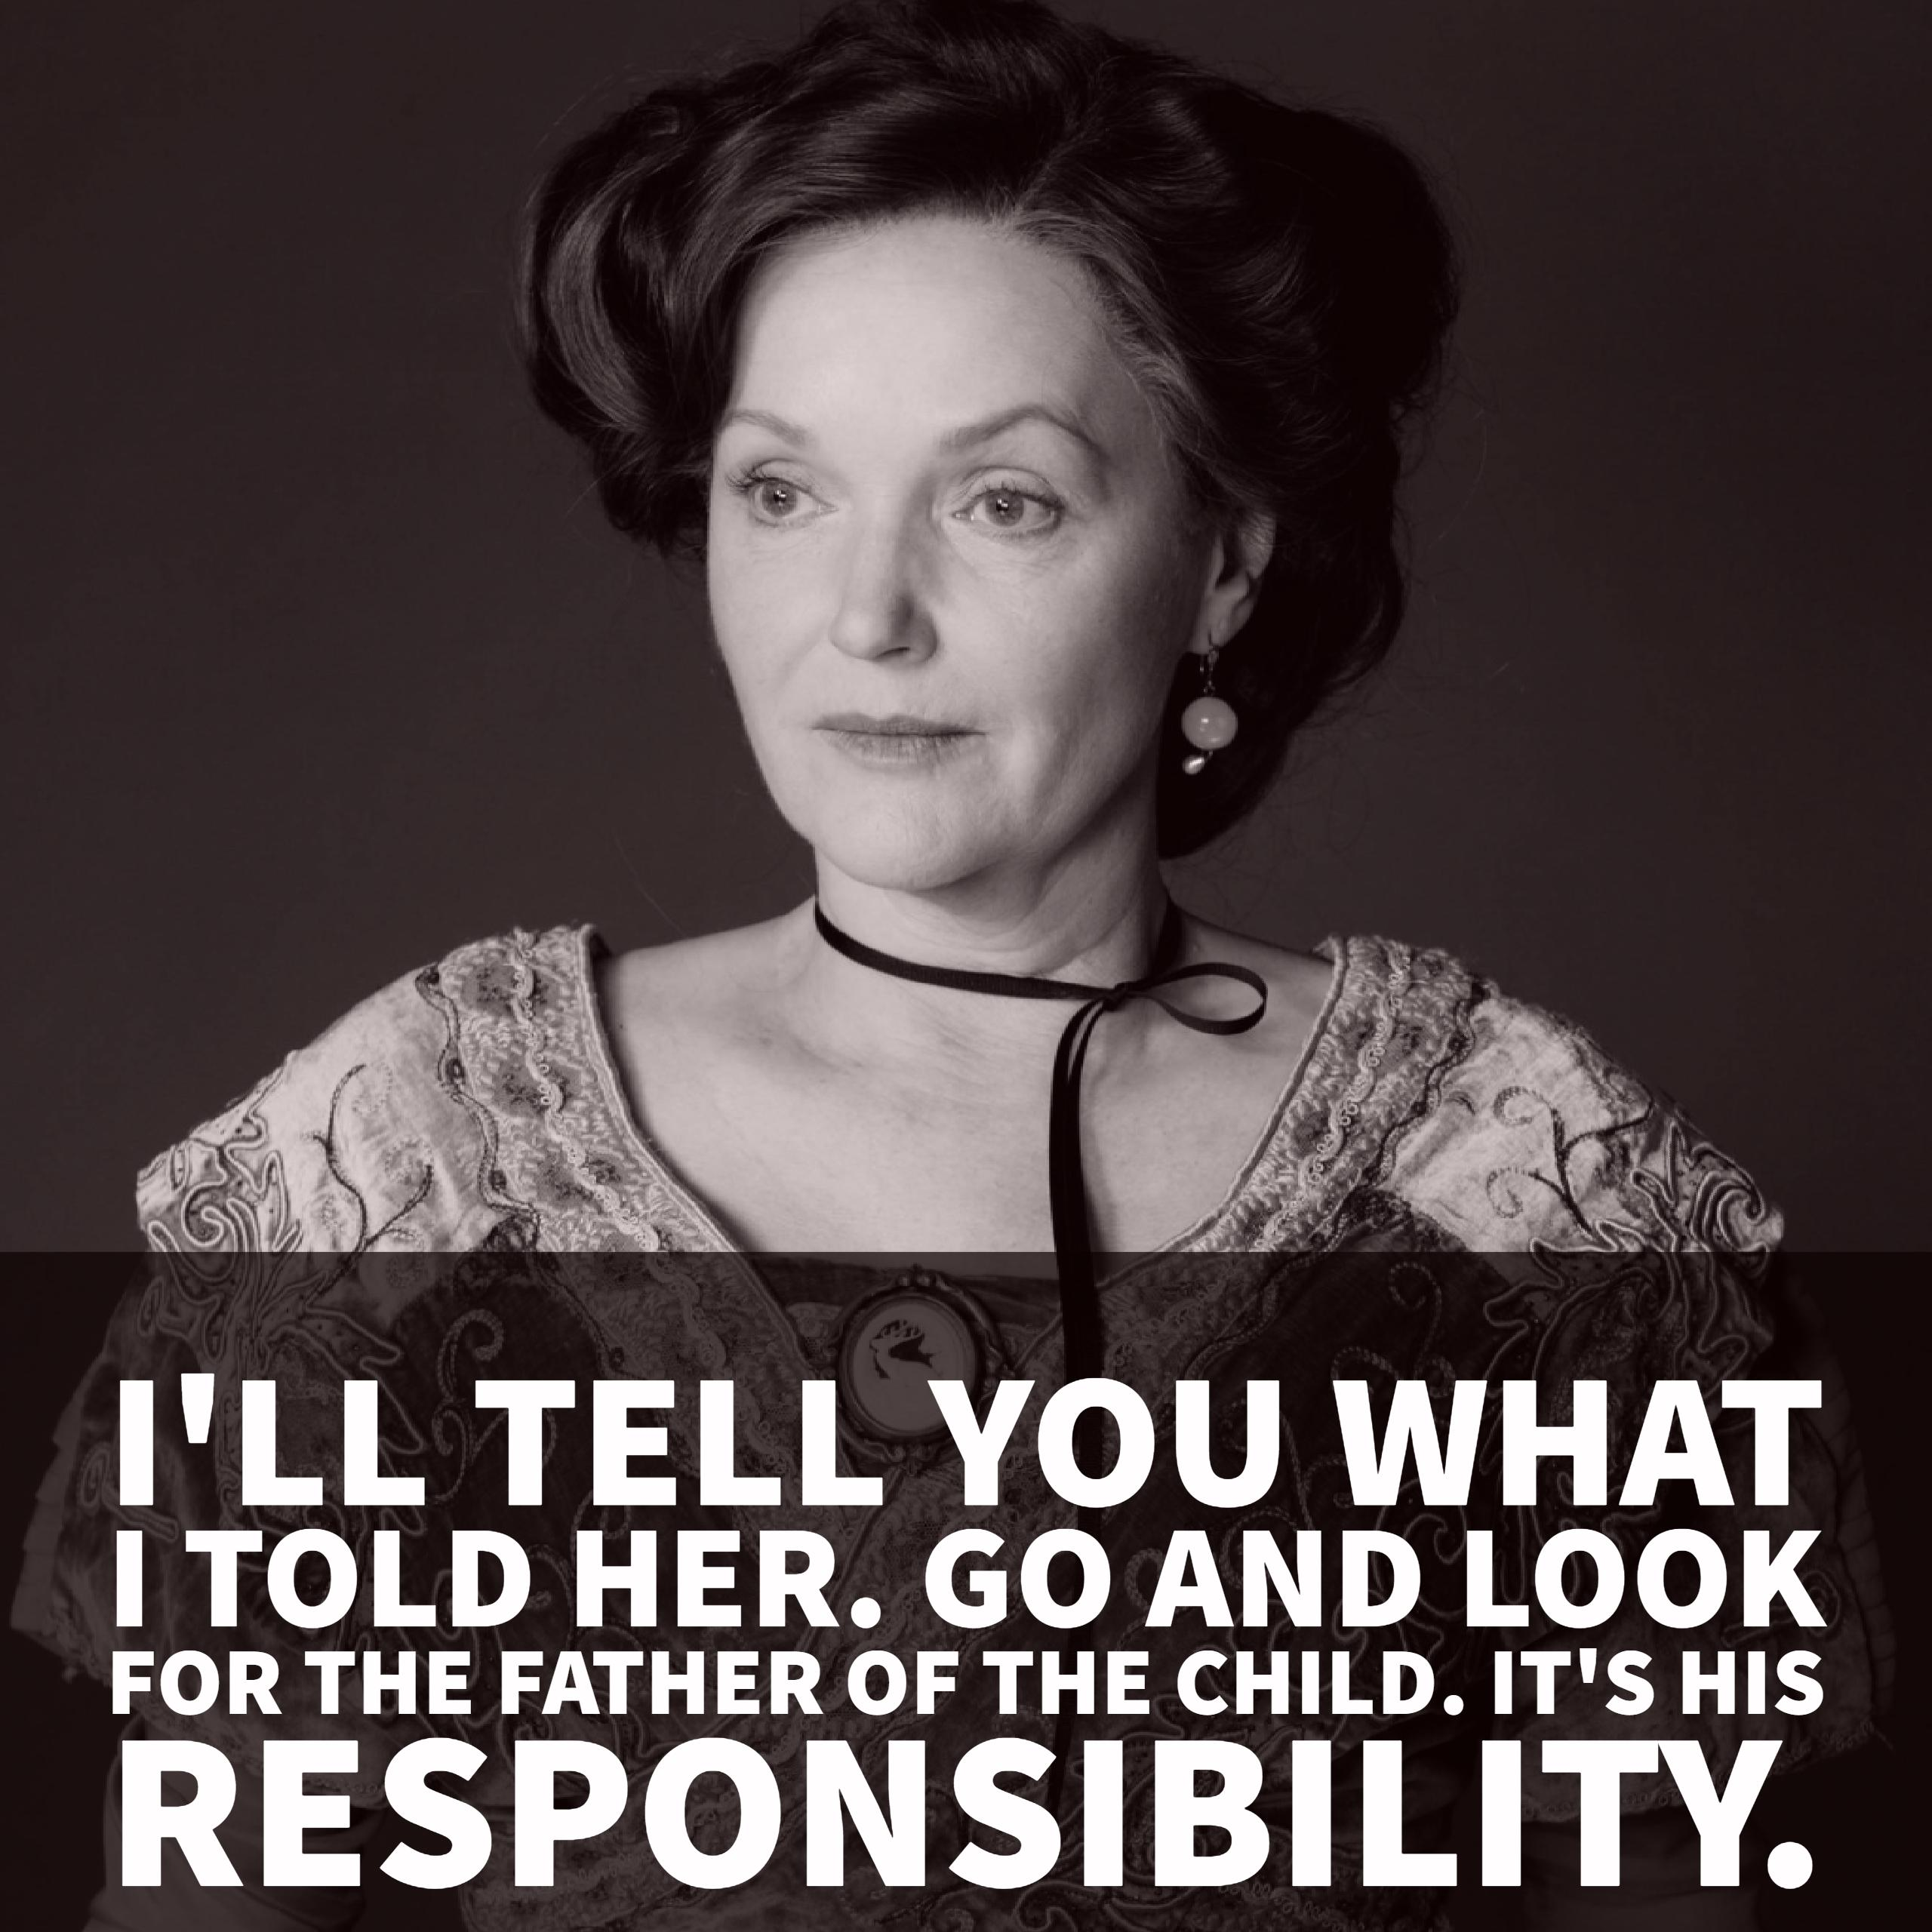

Slide 3
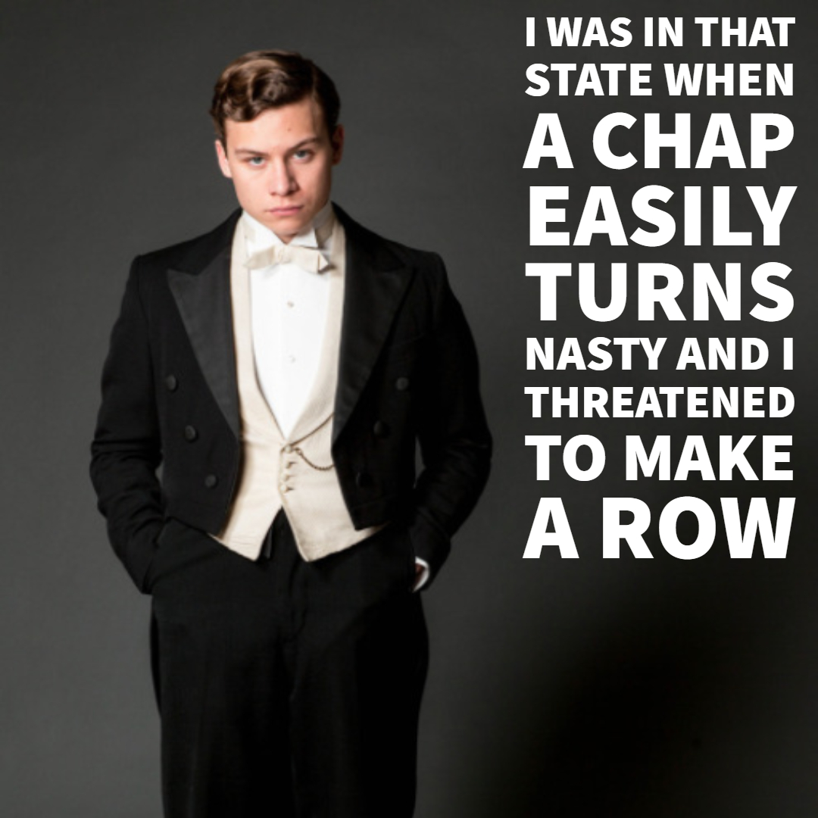

Slide 4
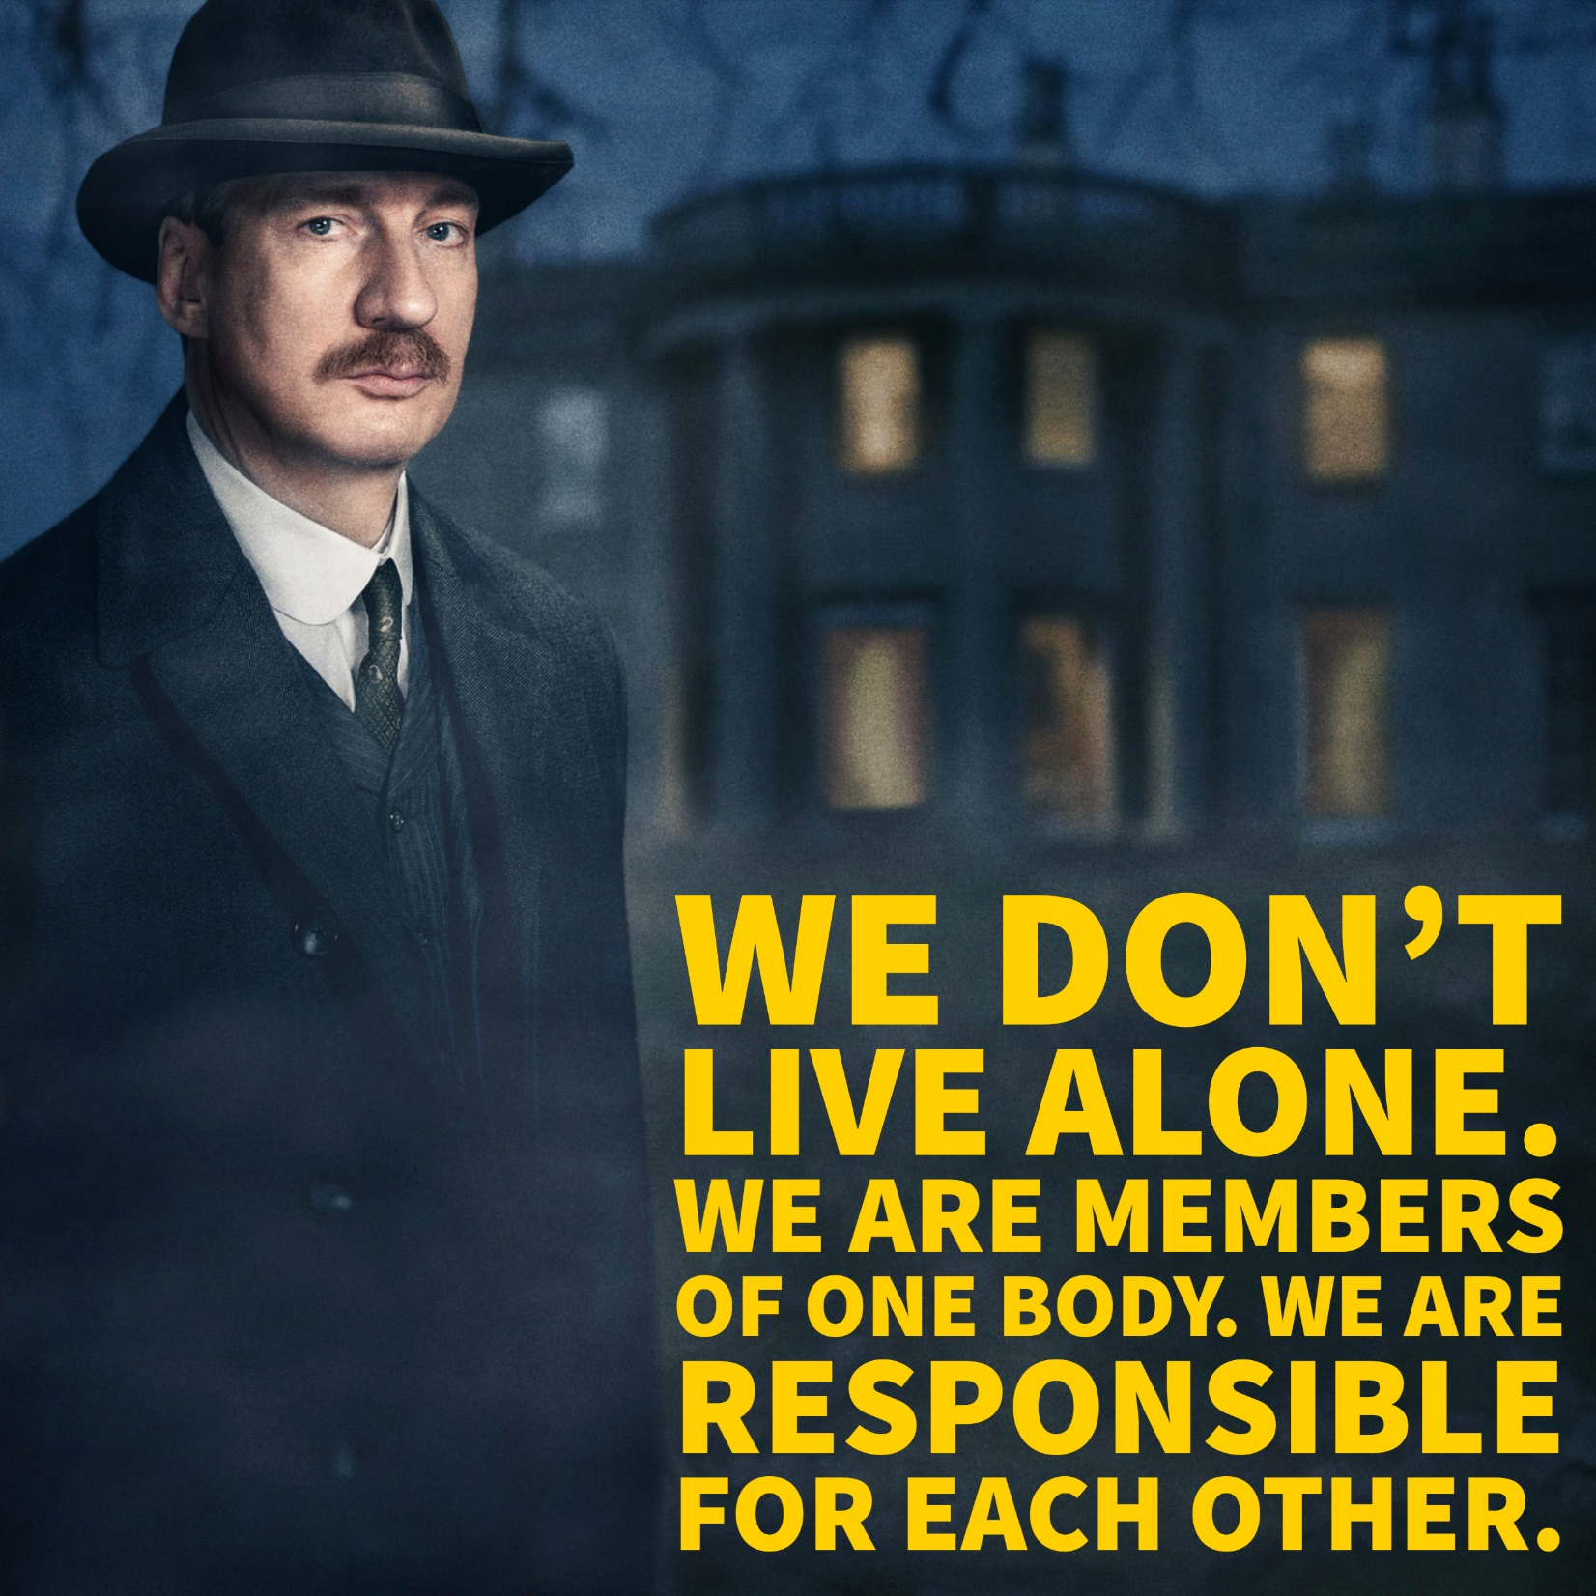

Slide 5
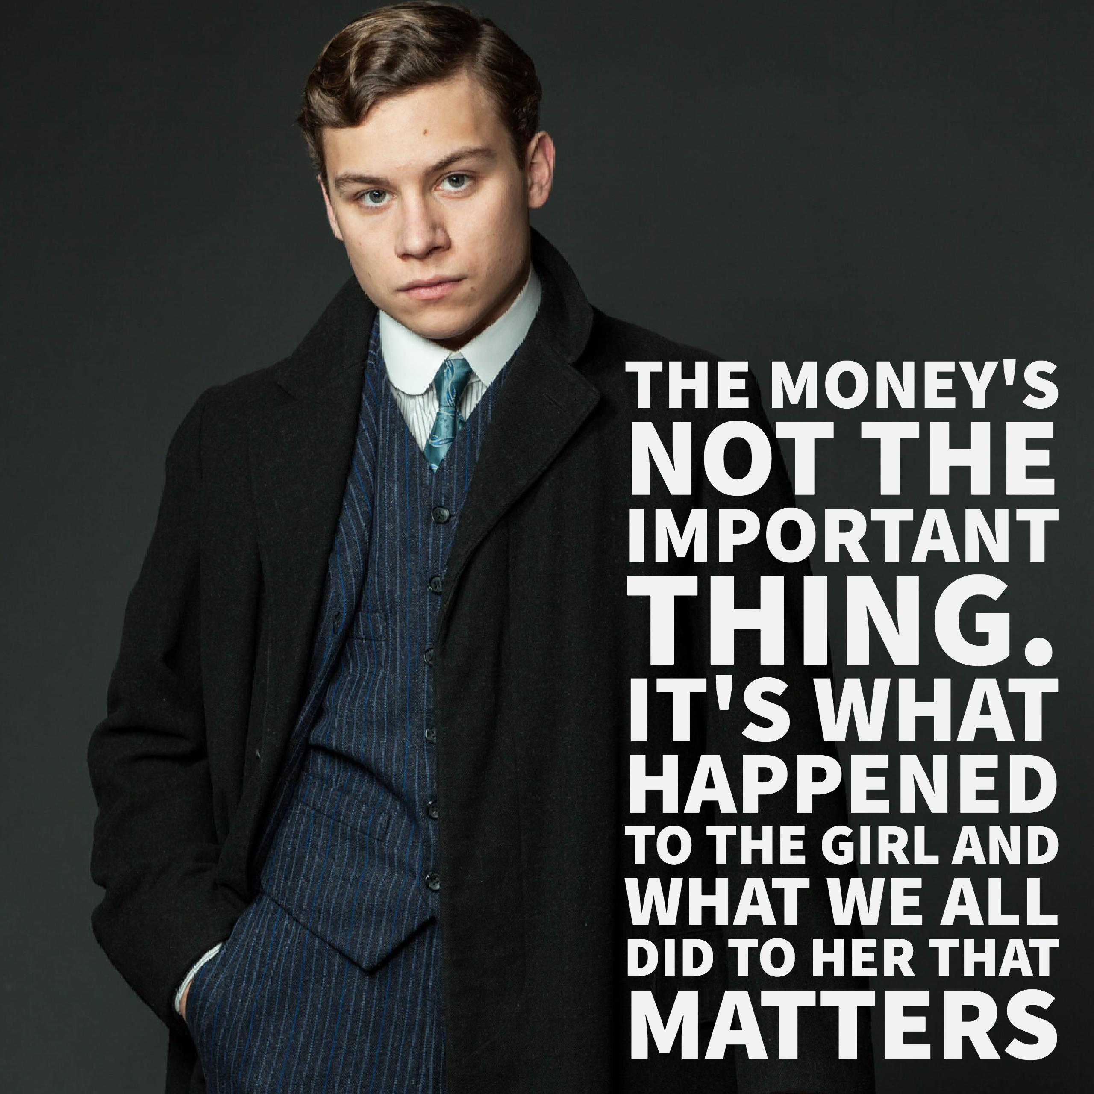

Slide 6
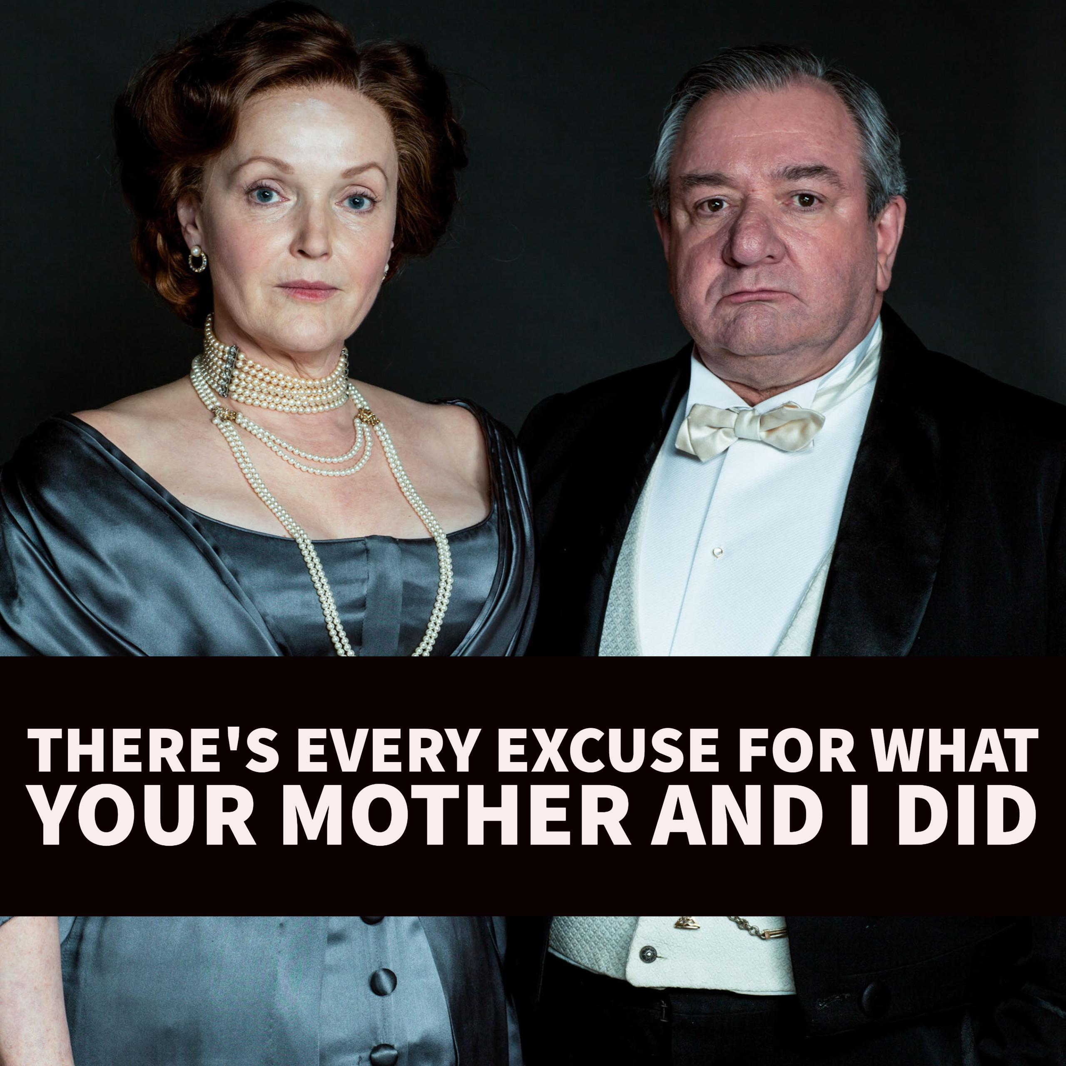

Slide 7
Learn these quotes from Act Three
‘The father of the child. It’s his responsibility’ Mrs Birling
‘I was in that state when a chap easily turns nasty’ Eric
‘We don’t live alone, We are members of one body’ Inspector
‘Money’s not the important thing…it’s what happened to the girl’ Eric
‘There’s every excuse for what your mother and I did’ Mr Birling

Slide 8
Can you remember them?
‘The ______of the child. It’s his_______’ Mrs Birling
‘I was in that state when a______________’ Eric
‘We don’t live_______, We are members of______’ Inspector
‘_______not the important thing…it’s what happened to______’ Eric
‘There’s _________for what your mother and I did’ Mr Birling

Slide 9
How did you do?
‘The father of the child. It’s his responsibility’ Mrs Birling
‘I was in that state when a chap easily turns nasty’ Eric
‘We don’t live alone, We are members of one body’ Inspector
‘Money’s not the important thing…it’s what happened to the girl’ Eric
‘There’s every excuse for what your mother and I did’ Mr Birling

Slide 10
‘The father of the child. It’s his responsibility’ Mrs Birling
The structure of the play (with Eric out of sequence, after Mrs B) means the dramatic irony is powerful here
Effect on the audience?
Technique?
Vocabulary ‘responsibility’ + dramatic irony
Connotations and synonyms?
Image created?
Priestley has ‘responsibilty’ as a key theme in the play
We partly agree, but can see she is passing on the blame – like Birling and Gerald have done

Slide 11
‘I was in that state when a chap easily turns nasty’ Eric
The harsh reality of the brutal treatment of working class girls like Eva is revealed by Priestley. We feel sorry for her.
Technique?
Effect on the audience?
Euphemism + understatement
Connotations and synonyms?
As a ‘chap’ Eric’s actions sound like a childish error. He is admitting to raping a vulnerable woman.
Priestley uses Eric to show how a capitalist view of life might sound harmless but hides the abuse and misery it can lead to for the poor and working classes.
Image created?

Slide 12
‘We don’t live alone, We are members of one body’ Inspector
Priestley gives The Inspector a speech where he voices Priestley’s own socialist ideas JUST BEFORE he leaves the stage – we learn from it
Technique?
Effect on the audience?
metaphor
Connotations and synonyms?
The metaphor of society as ‘one body’ links us all as one being.
There are religious connotations of ‘one flesh’ – God does not distinguish between classes and nor should we
Image created?

Slide 13
‘Money’s not the important thing…it’s what happened to the girl’ Eric
We realise Eric has learned and has changed. Priestley hopes we will too,
Effect on the audience?
Technique?
Contrast. Plain speaking
Connotations and synonyms?
Image created?
Money = capitalist
Girl = socialist
The contrast emphasises socialist ideas. The plain speech echoes the Inspector

Slide 14
‘There’s every excuse for what your mother and I did’ Mr Birling
alliteration
We are shocked that Birling has not changed. Priestley shows the young must lead the way in change for society.
Effect on the audience?
Technique?
Connotations and synonyms?
Image created?
The older generations will not learn. The young people need to change society and break away from the old ways.
He is still confident and arrogant

Slide 15
Dazzle the examiner
In the language used by Eric during this act Priestley shows how it is possible for change to be achieved. As Eric starts making excuses for his behaviour Priestley makes him refer to himself as a ‘chap’ to sound harmless and he says he could ‘easily turn nasty’ as a euphemism for the violence associated with heavy drinking. However, later in the Act Eric has learned and speaks directly, his plain speech echoing the Inspector: ‘Money’s not the important thing’…’it’s what happened to the girl’. As Eric is part of the younger generation Priestley is demonstrating that social change is possible and despite the violence committed by Eric there seems to be hope that he will live differently from now on.

