Slide 1
Quotes from An Inspector Calls

Slide 3
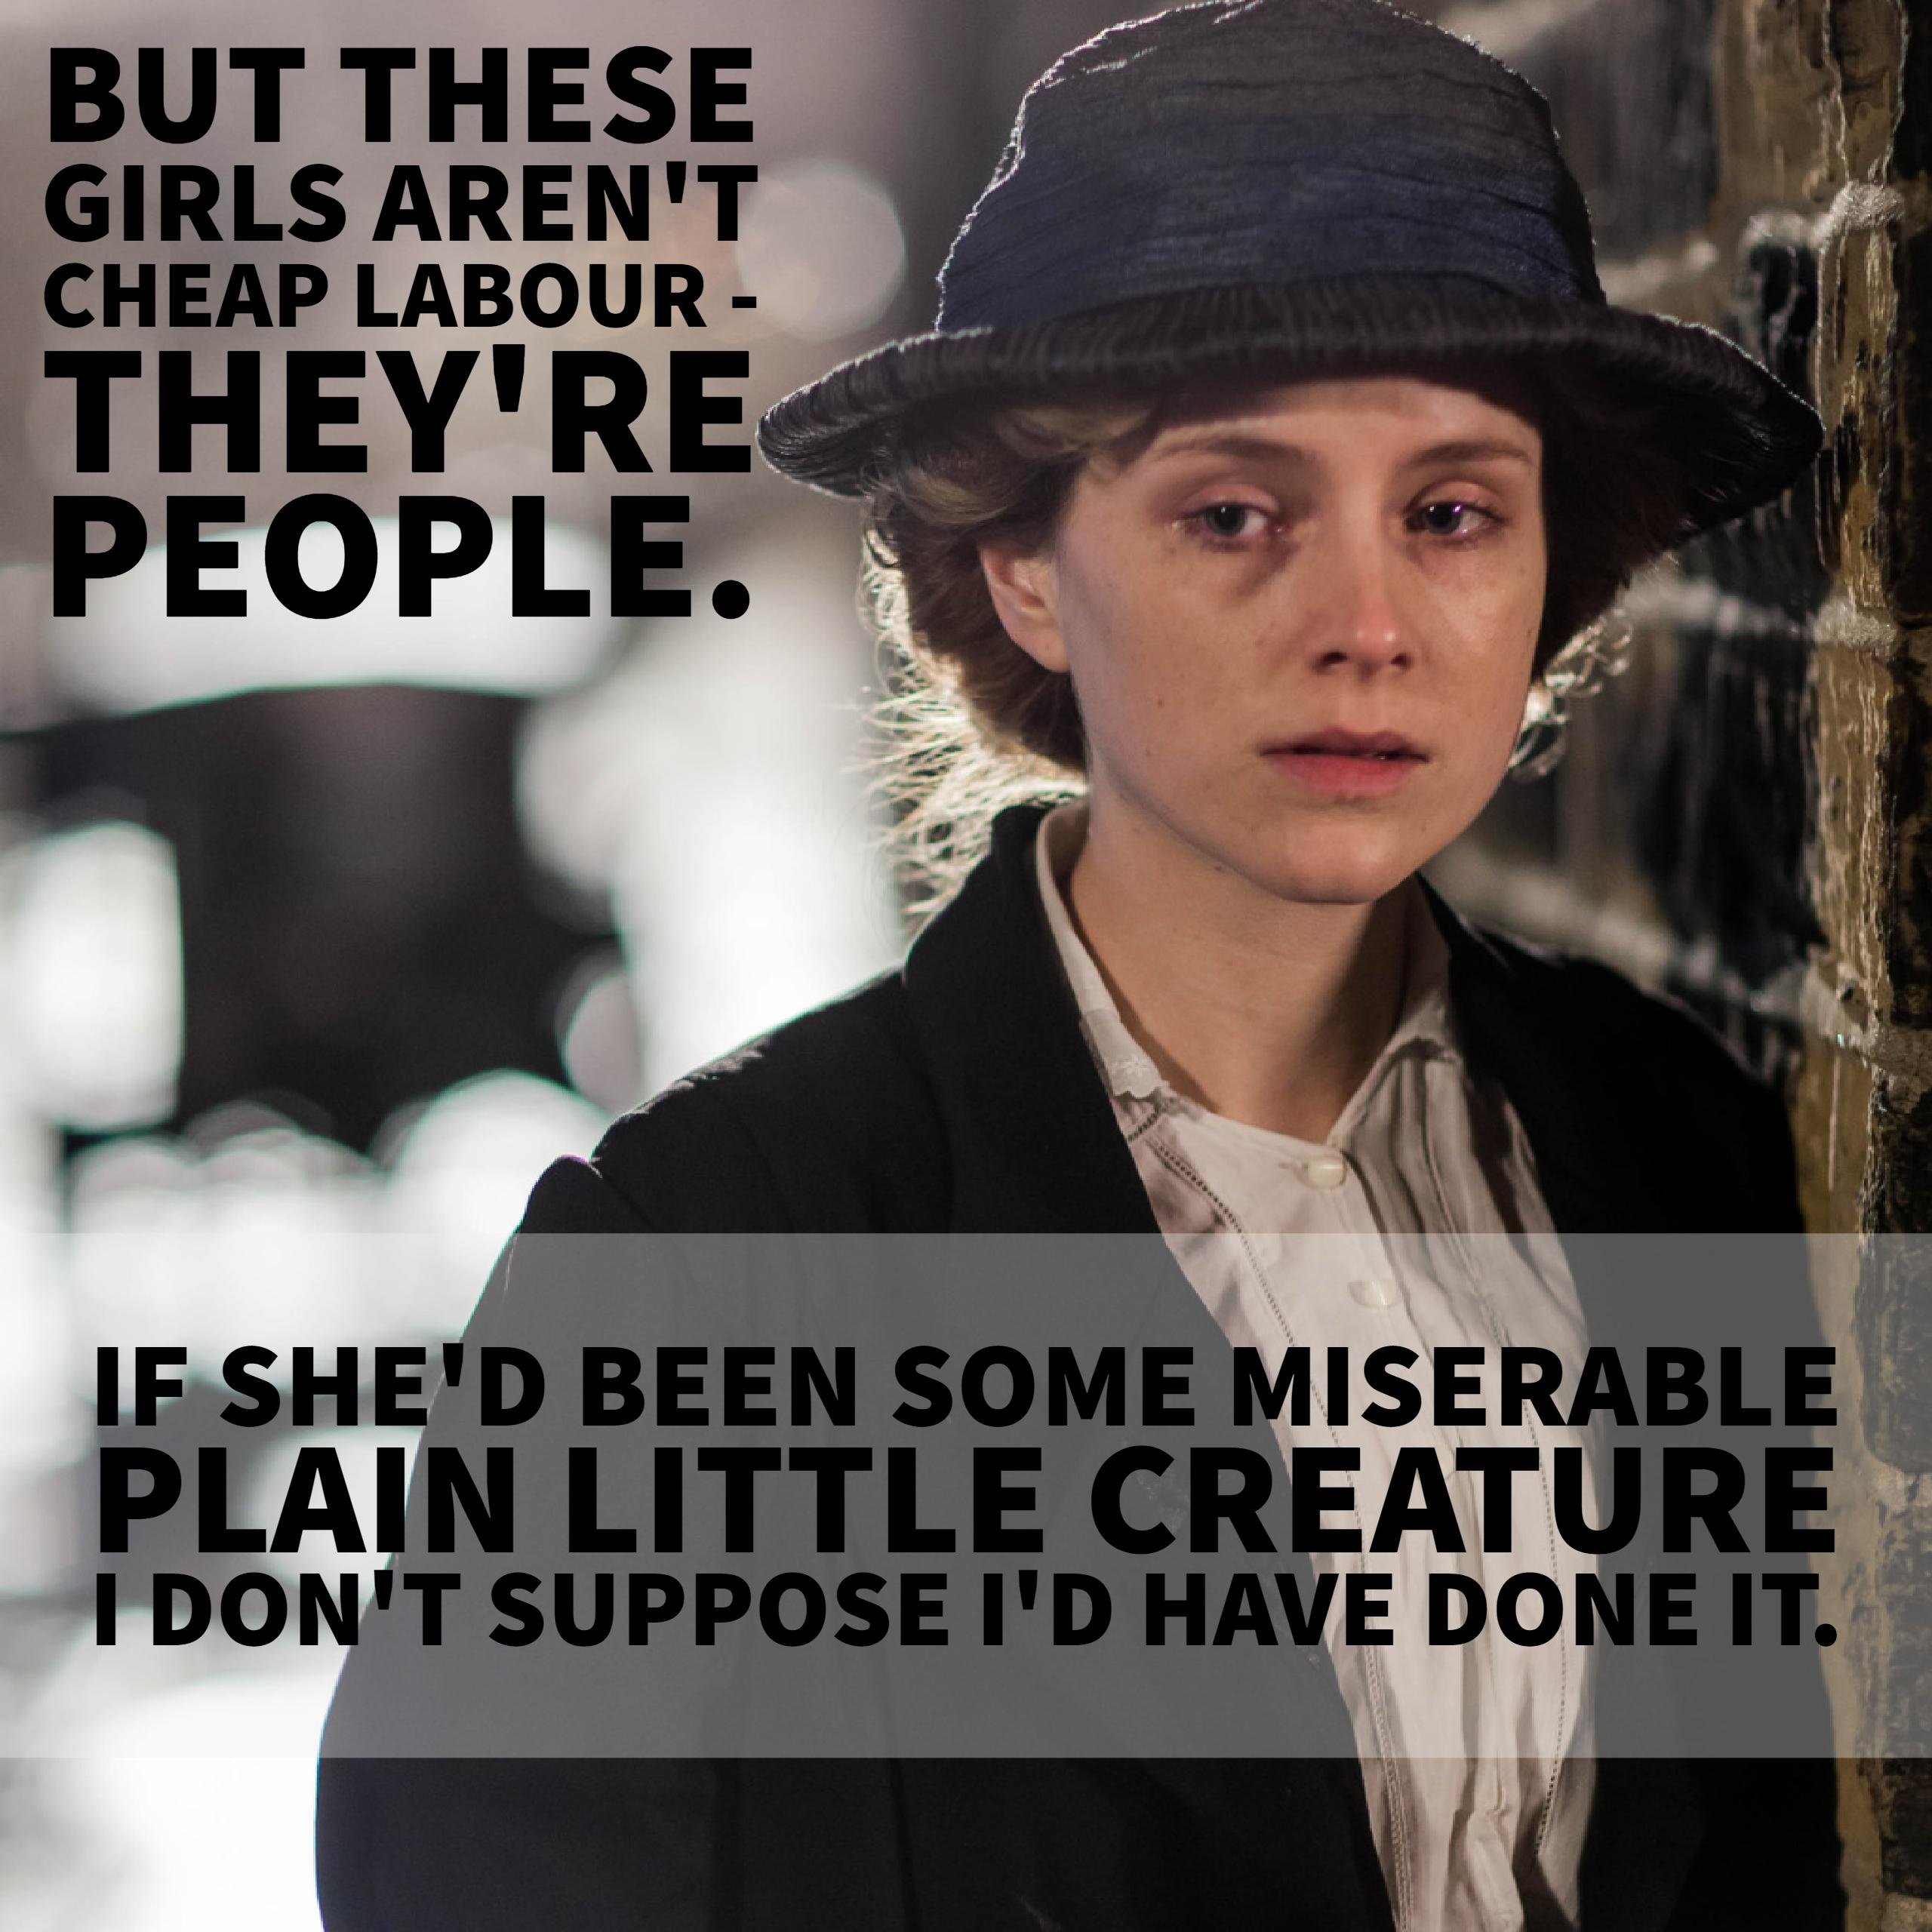

Slide 4
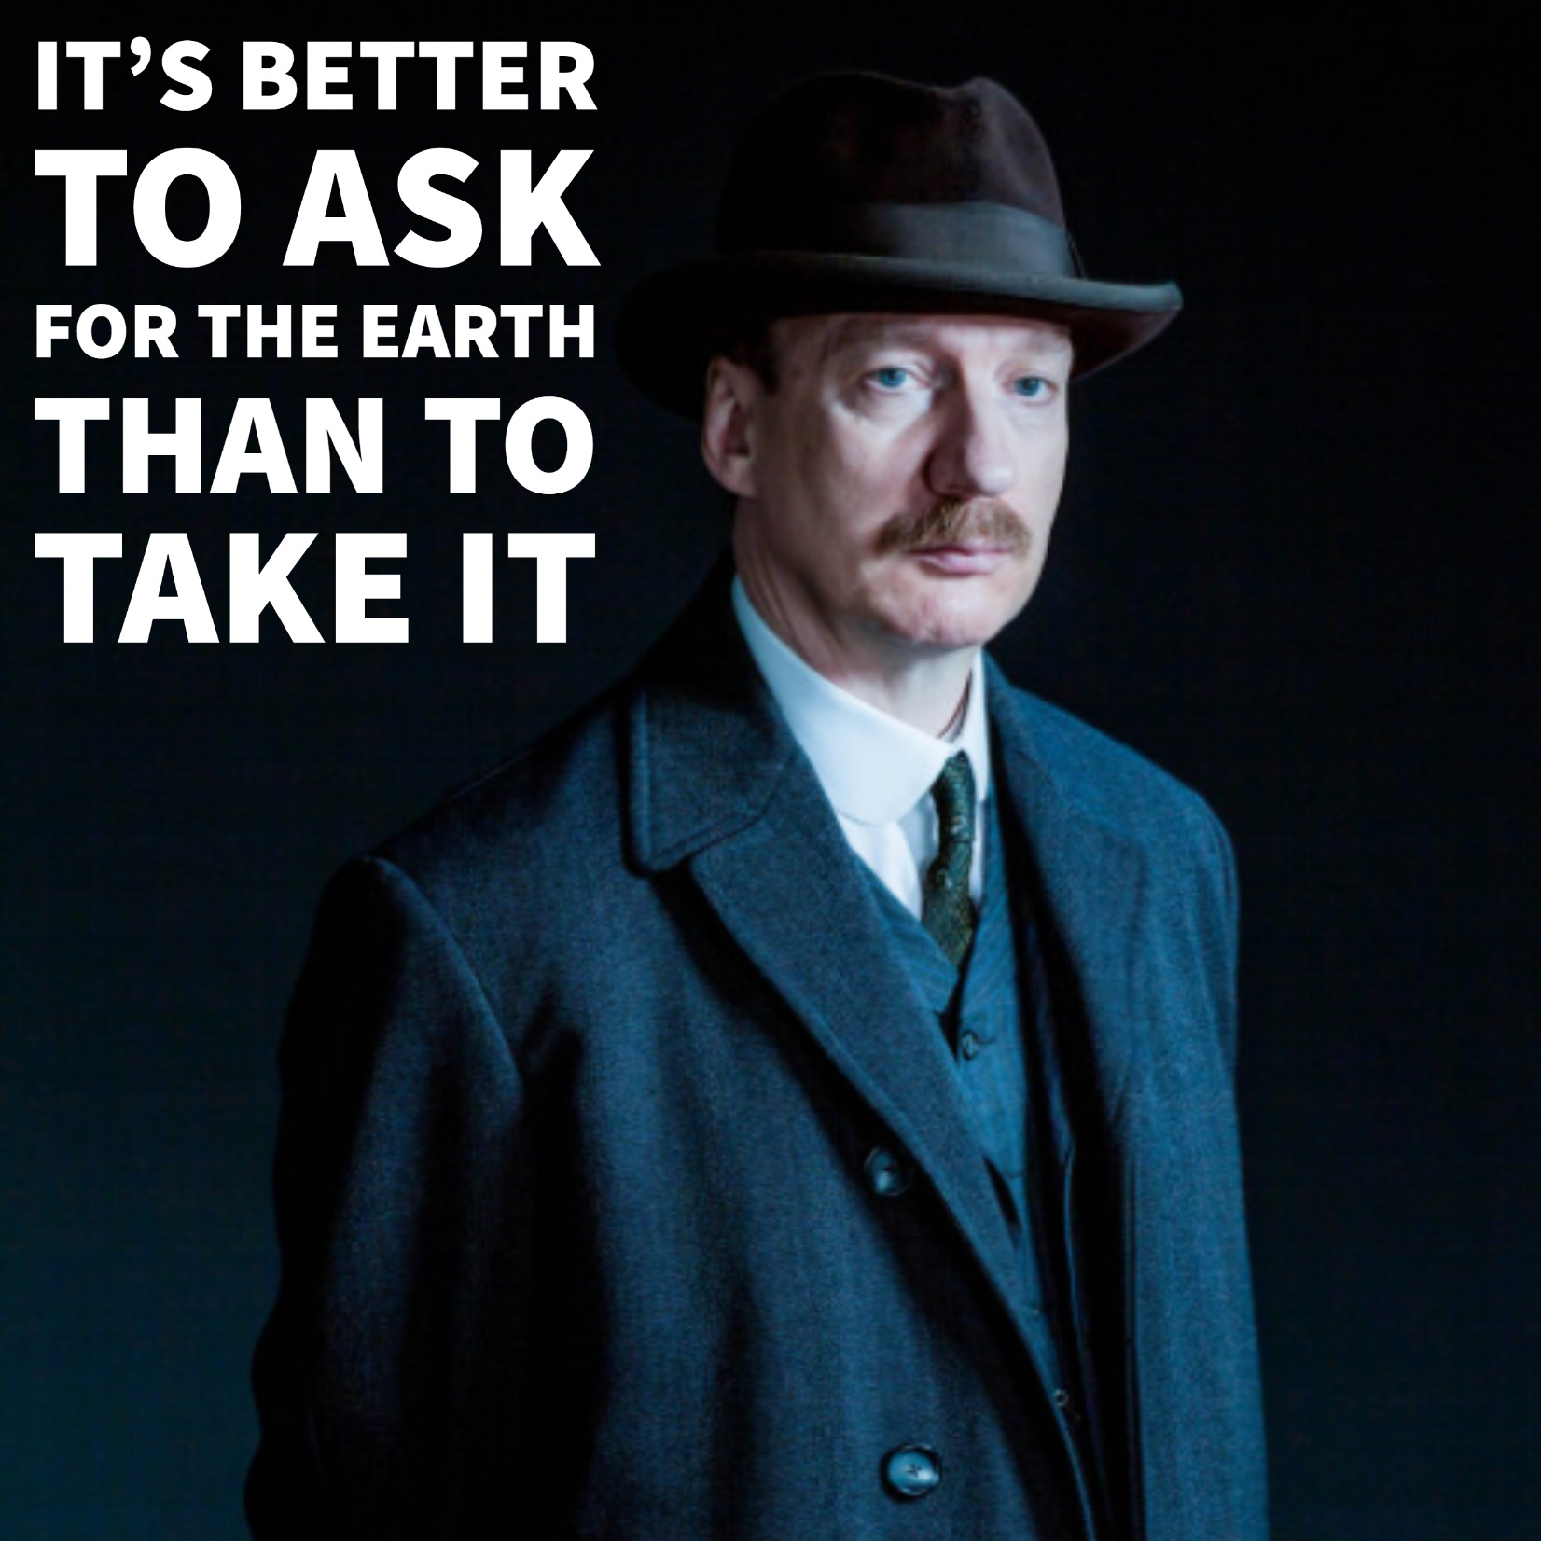

Slide 5
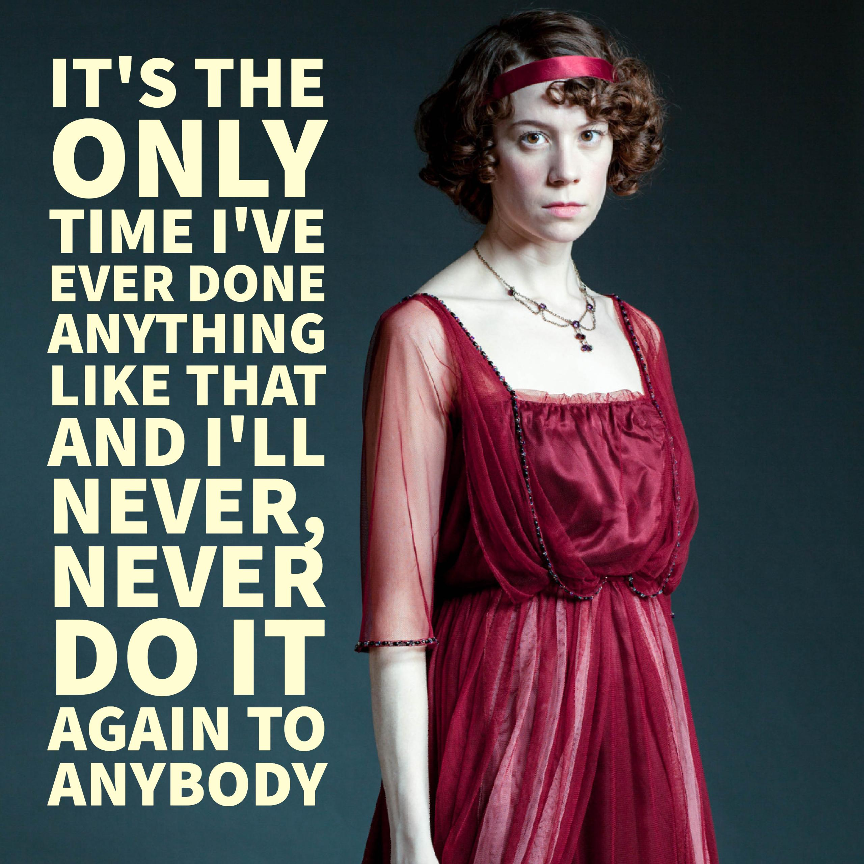

Slide 7
Learn these quotes from An Inspector Calls
‘We’re respectable citizens, and not criminals’ Gerald
‘These girls aren’t cheap labour, they’re people’ Sheila
‘It’s better to ask for the earth than to take it’ Inspector
‘I’ll never, never do it again to anybody’ Sheila
‘I didn’t ask for anything in return’ Gerald

Slide 8
Can you remember them?
‘We’re ________citizens, and not ______’ Gerald
‘These girls aren’t___________, they’re people’ Sheila
‘It’s better to ____for the earth than to ____it’ Inspector
‘I’ll _________do it again to _______’ Sheila
‘I didn’t ask for anything________’ Gerald

Slide 9
How did you do?
‘We’re respectable citizens, and not criminals’ Gerald
‘These girls aren’t cheap labour, they’re people’ Sheila
‘It’s better to ask for the earth than to take it’ Inspector
‘I’ll never, never do it again to anybody’ Sheila
‘I didn’t ask for anything in return’ Gerald

Slide 10
We wonder whether their actions should be criminal offences
Effect on the audience?
Technique?
Contrast
‘We’re respectable citizens, and not criminals’ Gerald
Image created?
The contrast of the two ideas makes us question them

Slide 11
‘These girls aren’t cheap labour, they’re people’ Sheila
We can see Sheila is learning and might question our own attitudes to the poor.
Technique?
Effect on the audience?
contrast
Connotations and synonyms?
Image created?
Priestley uses Sheila to bring in his own socialist message in the play. Treating people as a commodity is wrong.
Sheila starts to think of the working classes as real people for the first time. She still sees herself as separate though

Slide 12
‘It’s better to ask for the earth than to take it’ Inspector
Priestley gives the Inspector a line with clear socialist ideas – he is teaching Birling and the audience a lesson
Technique?
Effect on the audience?
Metaphor, hyperbole and contrast
Image created?
Connotations and synonyms?
The metaphor suggest the enormity of the injustice being done and that the rich are taking everything from the poor.
Is it really asking for ‘the earth’ to want a fair wage? The hyperbole suggests Priestley thinks Eva’s request is reasonable – and that workers should get fair pay.

Slide 13
‘I’ll never, never do it again to anybody’ Sheila
We realise Sheila is changing
Effect on the audience?
Technique?
repetition
That she has learned from her mistake
Connotations and synonyms?
Image created?
‘anybody’ suggests Sheila will no longer judge people on class

Slide 14
‘I didn’t ask for anything in return’ Gerald
First person
We see that Gerald is abusing his position – he has money and Daisy does not. She does not have a fair choice,
Effect on the audience?
Technique?
Gerald is excusing his behaviour
Connotations and synonyms?
Image created?
Gerald is linked to the upper middle class who do not judge themselves by the rules of right and wrong applied to the working class.

Slide 15
Dazzle the examiner
Priestley uses many patterns of contrast within the play such as…
These contrasts parallel the two opposing political views in the play which are…
They also highlight the divide between the poor working classes and the wealthy middle class. Priestley uses the contrasts to drive home his message that…

