Slide 1
Quotes from Act 1

Slide 2
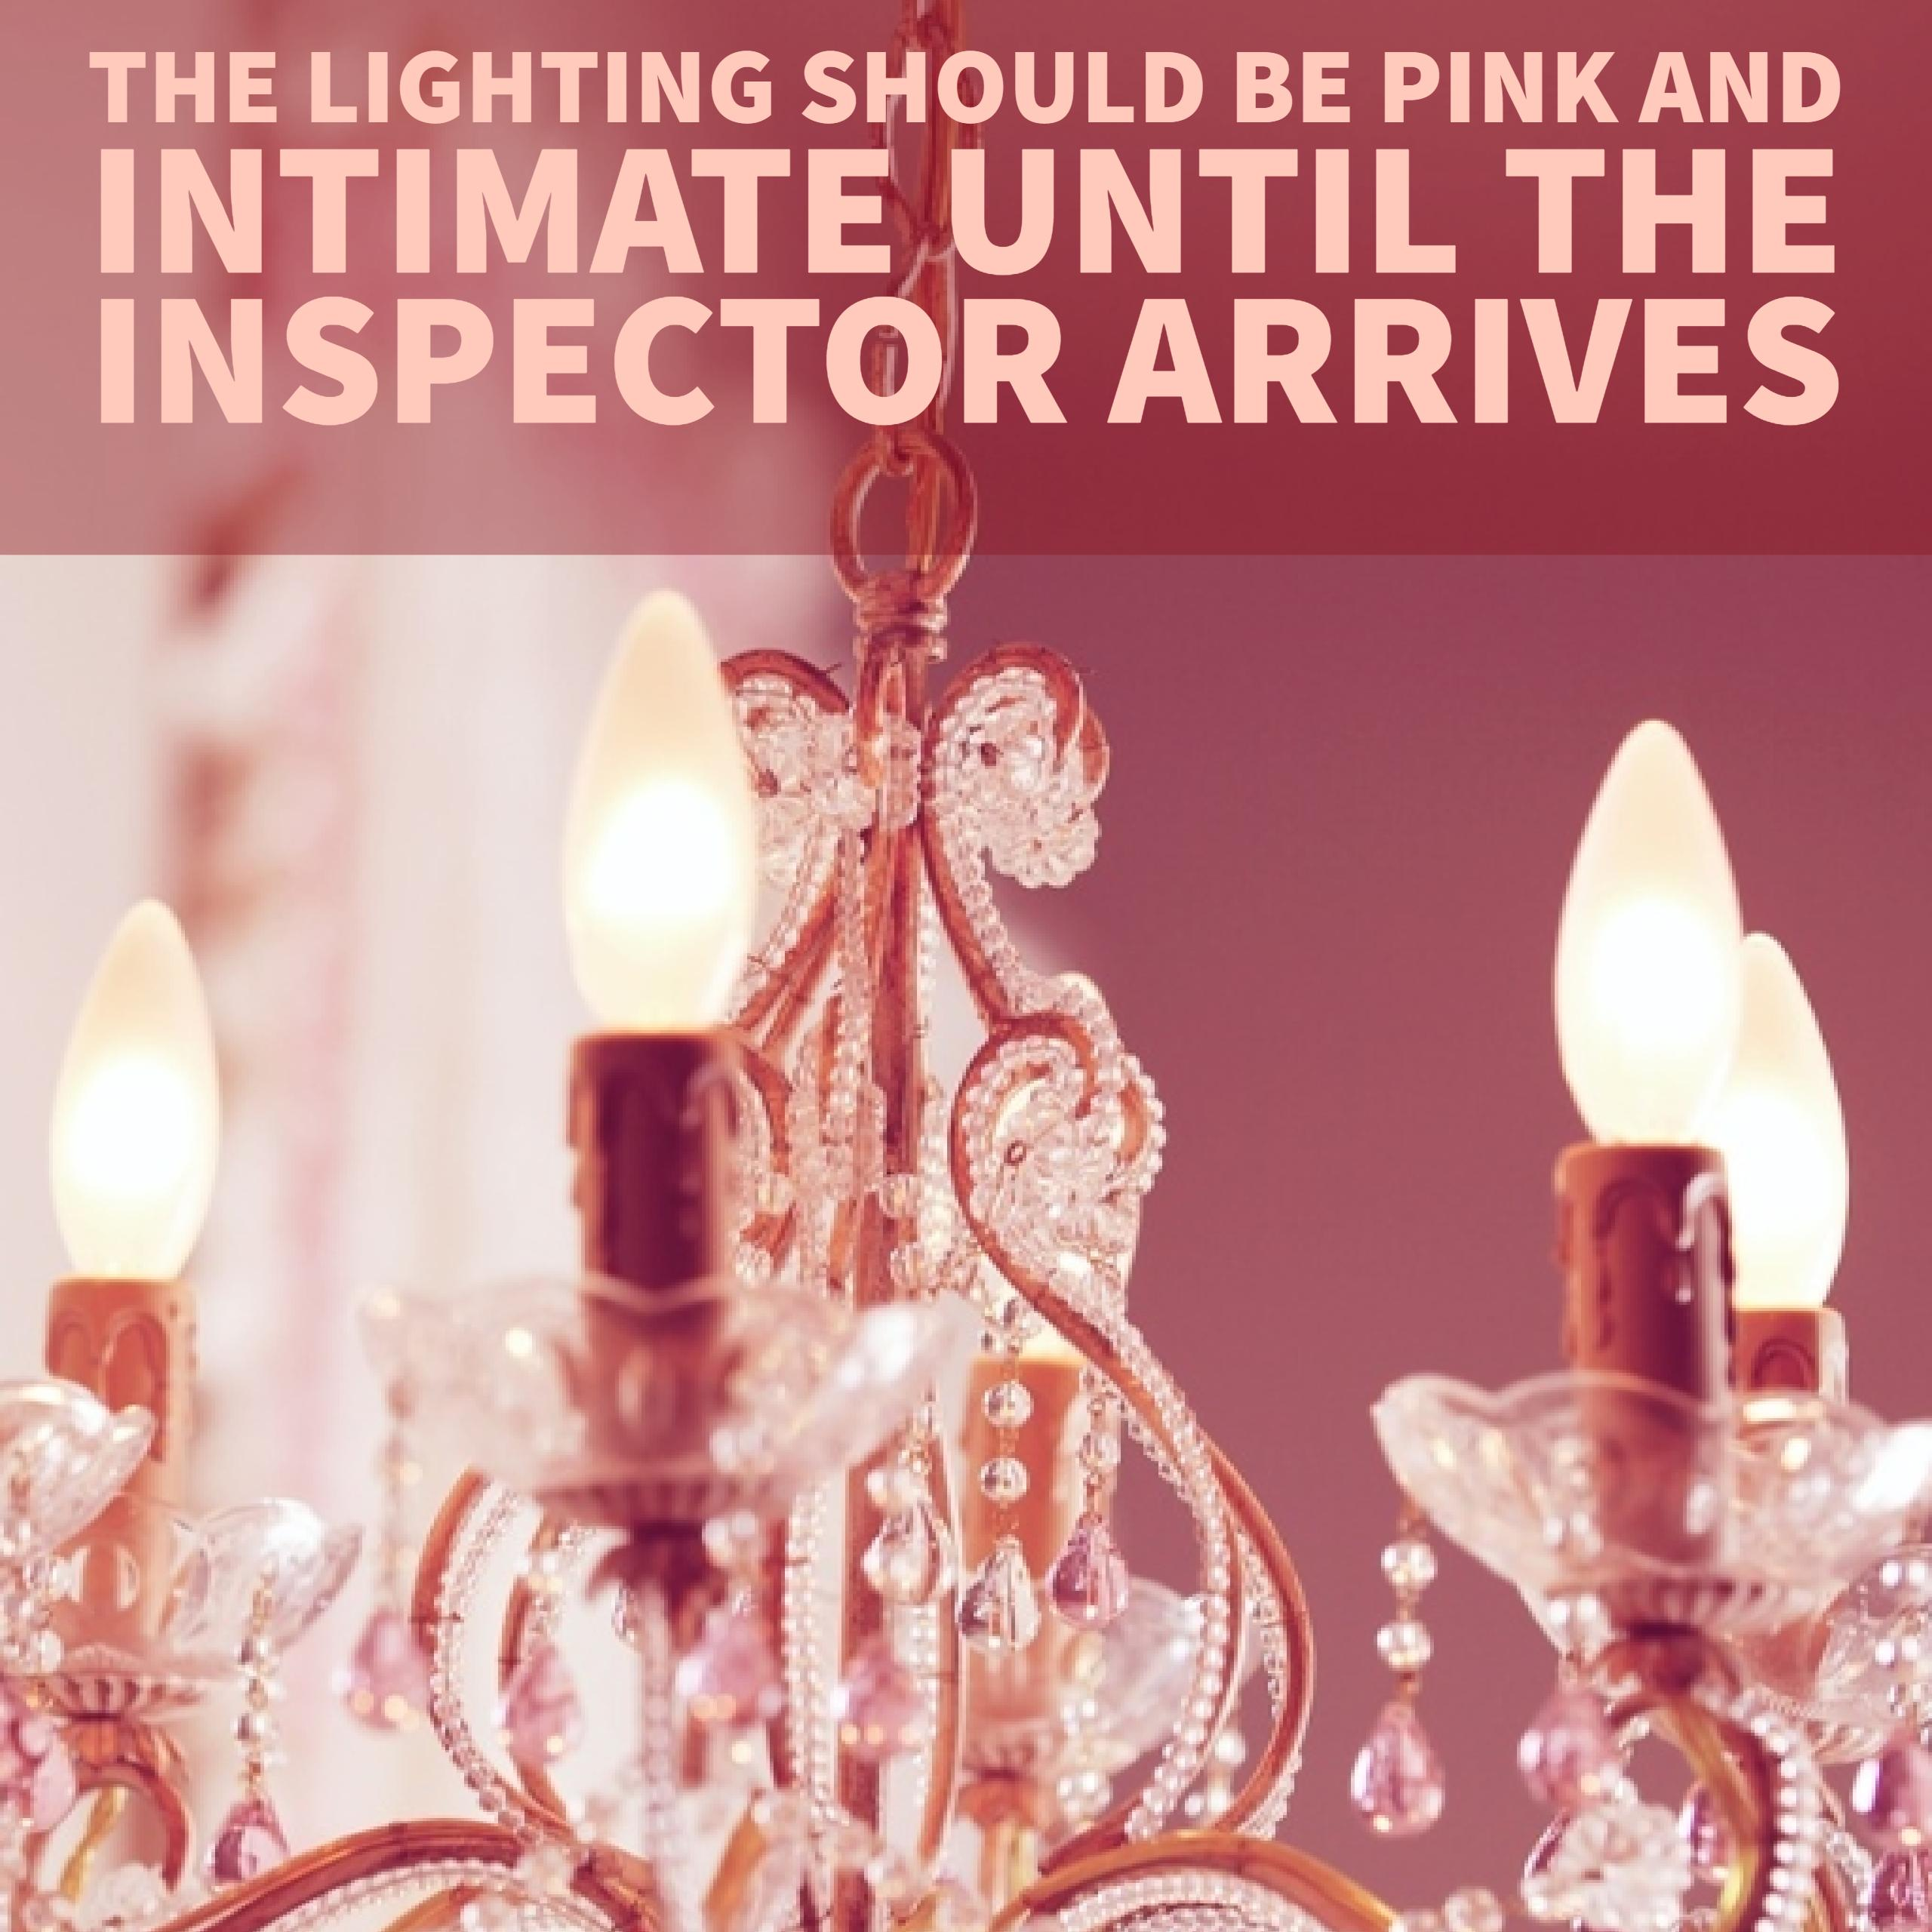

Slide 3
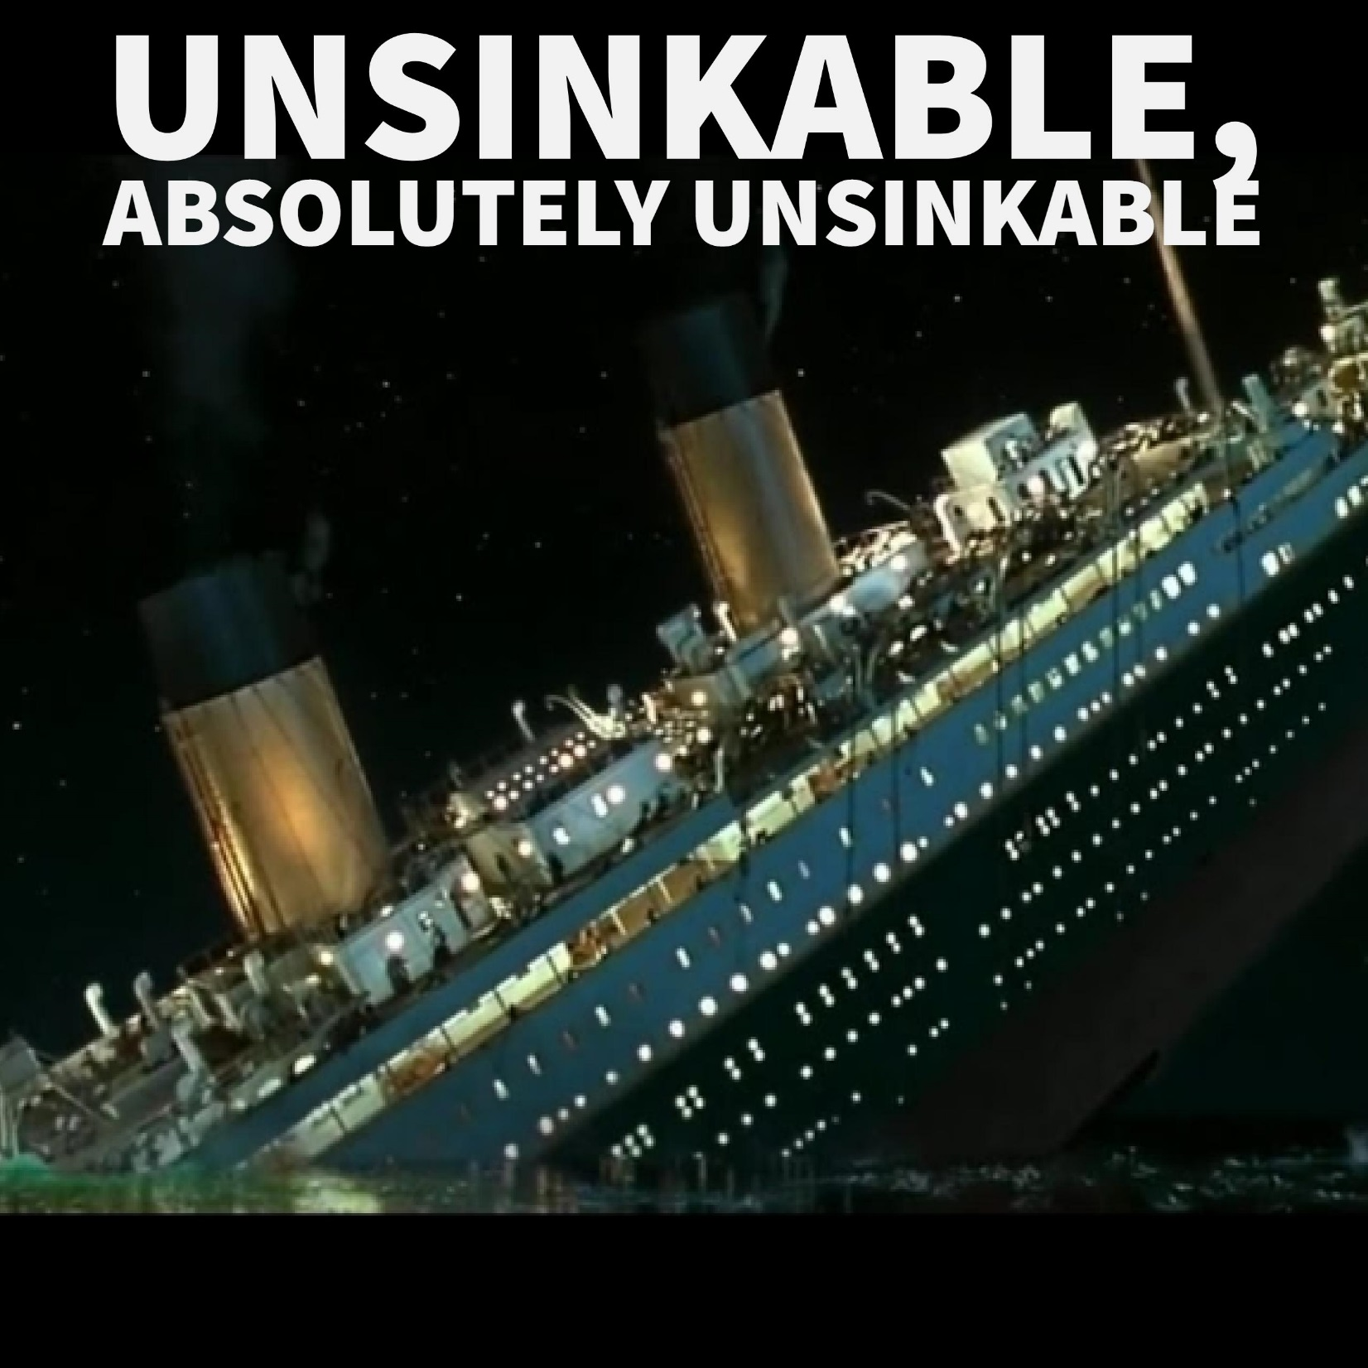

Slide 4
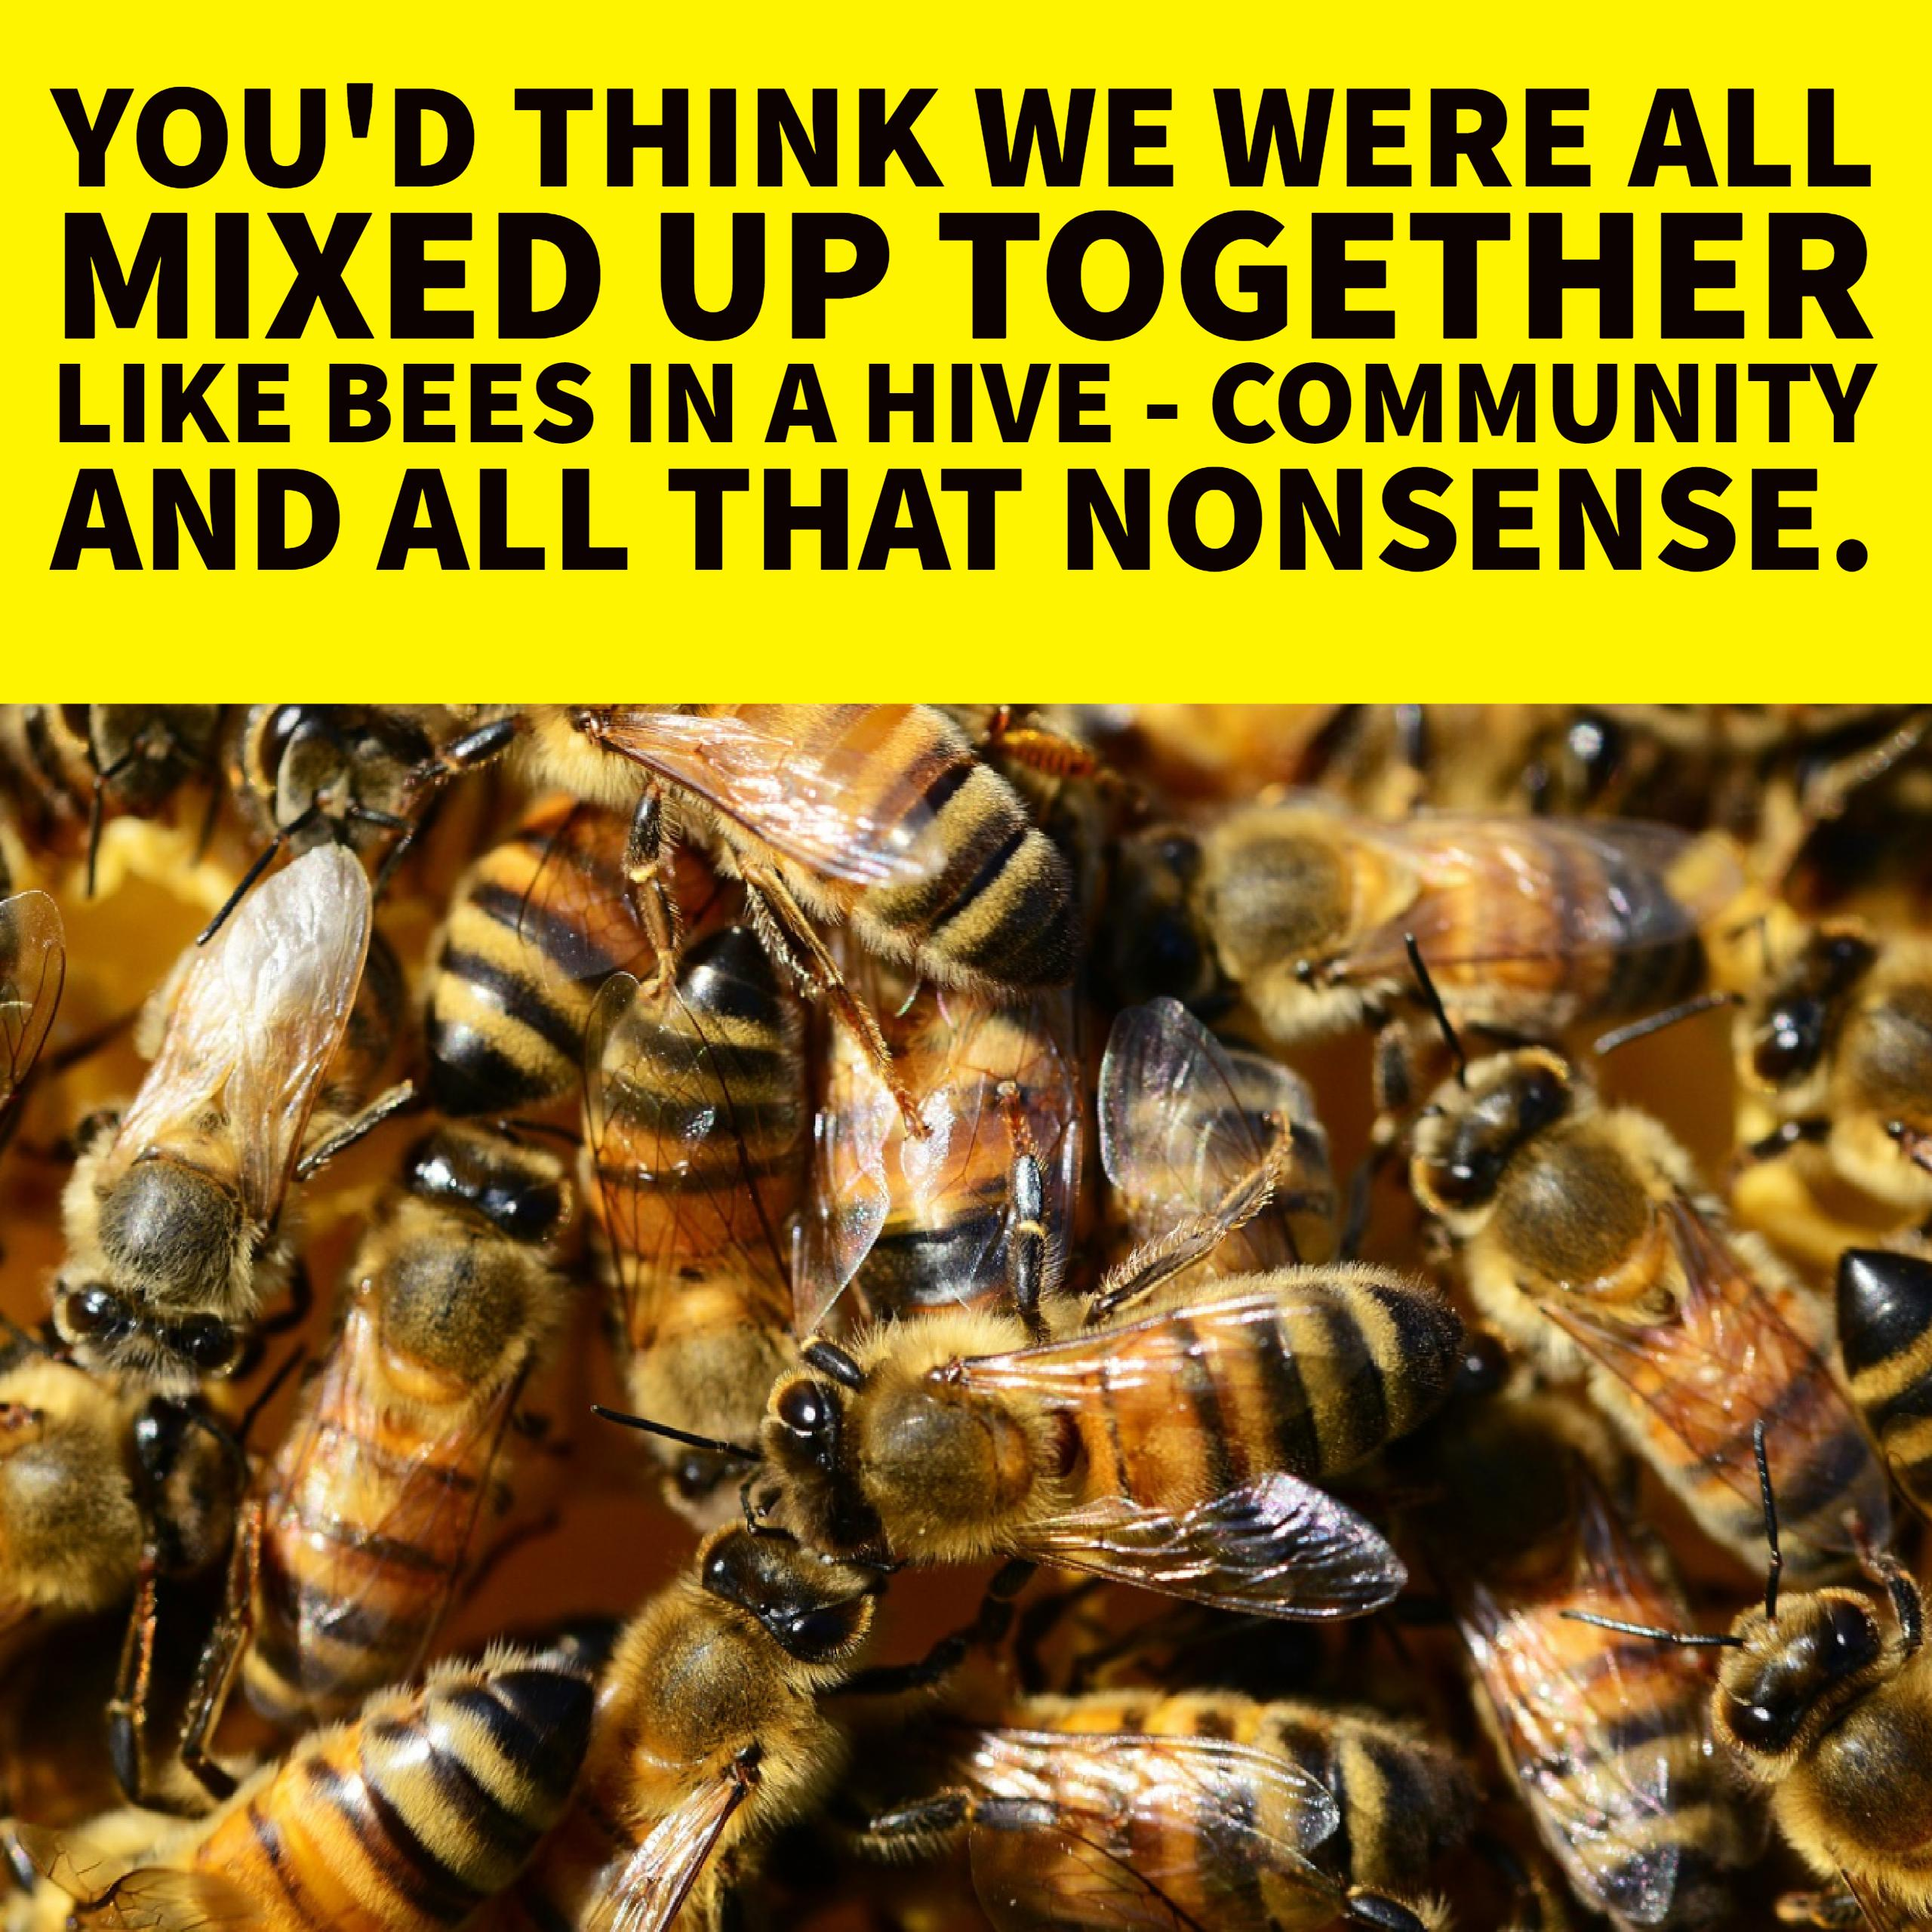

Slide 7
Learn these quotes from Act One
The lighting should be pink and intimate until the Inspector arrives - stage direction
‘Unsinkable, absolutely unsinkable’ Birling
‘You’d think we were all mixed up together…like bees in a hive’ Birling (just before the inspector arrives!)
‘A chain of events’ Inspector
‘Burnt her inside out of course’ Inspector

Slide 8
Can you remember them?
The lighting should be ________________until the Inspector arrives - stage direction
‘__________, absolutely__________’ Birling
‘You’d think we were all mixed up together… like______________________’ Birling (just before the inspector arrives!)
‘A _________of events’ Inspector
‘________her inside out of course’ Inspector

Slide 9
How did you do?
The lighting should be pink and intimate until the Inspector arrives - stage direction
‘Unsinkable, absolutely unsinkable’ Birling
‘You’d think we were all mixed up together…like bees in a hive’ Birling (just before the inspector arrives!)
‘A chain of events’ Inspector
‘Burnt her inside out of course’ Inspector

Slide 10
The lighting should be pink and intimate until the Inspector arrives - stage direction
Suggests they are cosy and complacent before the Inspector arrives
Effect on the audience?
Technique?
Stage direction
Connotations and synonyms?
Priestley uses the lighting to control the mood of the play
Image created?
Contrasts with the ‘brighter and harder’ lighting after the Inspector arrives

Slide 11
‘Unsinkable, absolutely unsinkable’ Birling
The audience know more about the Titanic than Birling. Priestley deliberately makes him sound lacking in sound judgement.
Technique?
Effect on the audience?
Repetition & dramatic irony
Priestley uses Birling to show a capitalist view of life, and to make the audience dislike what he stands for
Connotations and synonyms?
Image created?
He is over confident and arrogant. The adverb ‘absolutely’ shows he is sure he is right.

Slide 12
‘You’d think we were all mixed up together…like bees in a hive’ Birling (just before the inspector arrives!)
Priestley gives Birling a speech where he ridicules socialist ideas JUST BEFORE he introduces the Inspector
Technique?
Effect on the audience?
simile
Connotations and synonyms?
The simile compares people to bees – bees work together for the good of the hive
There is a ‘sharp ring’ on the door as the Inspector arrives, suggesting Birling is going to get a shock when his ideas are challenged
Image created?

Slide 13
‘A chain of events’ Inspector
The inspector is clearly well organised and takes control – he seems to know everything already
Effect on the audience?
Technique?
Metaphor
The ‘chain’ image is of strong links between people/their actions, that cannot be denied by the characters
Connotations and synonyms?
Image created?
Heavy industry, struggle

Slide 14
‘Burnt her inside out of course’ Inspector
Emotive language
We are shocked and have empathy for Eva/Daisy – even though we never see her
Effect on the audience?
Technique?
Eva’s desperation
Connotations and synonyms?
Image created?
Links to ideas of fire and hell – ‘fire and blood and anguish’ + ‘the hellish thing’

Slide 15
Dazzle the examiner
The emotive language used by the Inspector to describe Eva’s suicide, ‘burnt her inside out’ shocks both the audience and the characters on the stage. The connotations of burning link to Eric’s use of the adjective ‘hellish thing’ when he admits to his abuse of Eva, suggesting that his actions have far more serious consequences than he realises. Priestley uses the Inspector as his mouthpiece to claim it will lead to ‘fire and blood and anguish’ when the working classes finally rise up against the oppression of capitalism, perhaps in revolution.

