Slide 1
An Inspector Calls
J B Priestley

Slide 2
Why? What for?
GCSE Literature Paper 2
Section A…
Assessment | Question types | Target 1 - 4 | Target 4 - 6 | Target 6 - 9
AO1 - 40%; AO2 - 40%; AO3 - 20%; AO4 – SPAG (4 marks) | CHOICE ‘How does Priestley present / explore [theme] in the play?’ ‘How and why does [character act in a certain way] in the play?’ | Know the main events and the characters, and what they are like, as well as the main ideas in the play | Know the key characters /themes and how they contribute to the story, as well as the key messages | Know the key characters / themes in detail, analysing how they develop the plot and connect to the context and message – the intent of the author

Slide 3
A journey?…
AO1a –
make a point related to the question - S
AO1b –
support the statement with a quote or reference - Q
AO2 –
look at the meaning / language / effect of the quote and show some analysis or inference - I
AO3 –
link the SQI to context or themes to show an understanding of relationships

Slide 6
Quick Starter Game!

Slide 7
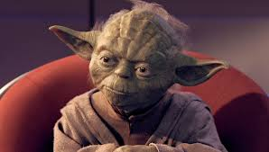
“Calls, An Inspector!”
Work out the original quote, write it down – and make a note of who says it

Slide 8
“Make his own way, a man must”

Slide 9
“Inside burnt out, it was…in great agony, she was”

Slide 10
“Far too much to say she had…to go she had”

Slide 11
“Any responsibility, I can’t accept”

Slide 12
“Mean thing, it was. Spoilt everything it might”

Slide 13
Developing – how well do you know the plot?

